Slide 1
QTL Mapping in Maize
Merritt Burch
Buckler Lab Presentation
October 10, 2018

Slide 2
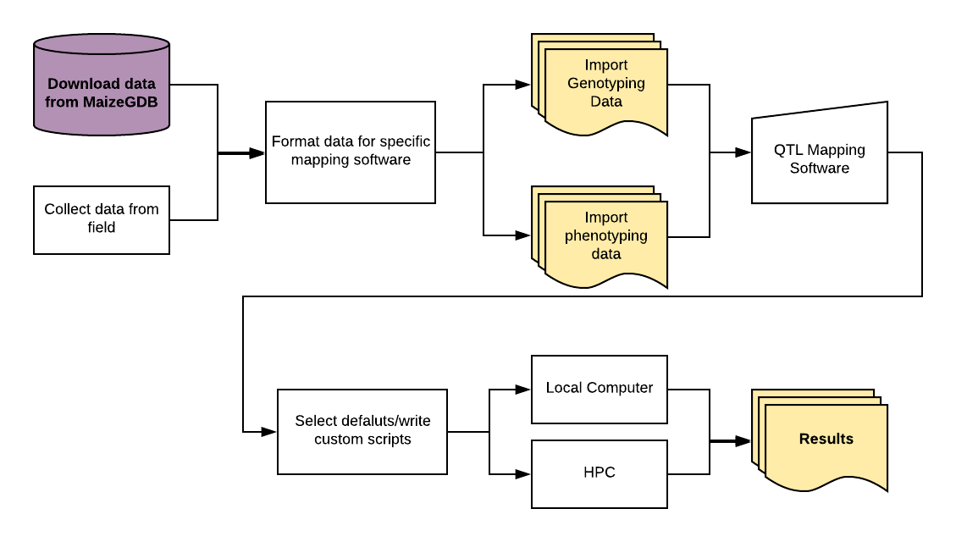

Slide 3
Existing QTL Mapping Software
Name | OS | Last Update
ICI Mapping | Windows | 2013
PLABMQTL | Windows | 2010
MapQTL | Windows | 2013
QTL Cartographer | Windows | 2012
QTL/QTL2 | R | Feb 2018

Slide 4
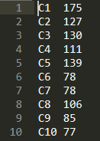
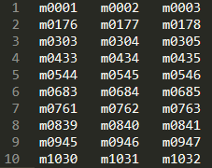

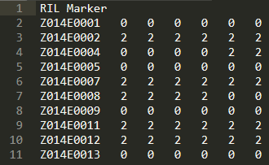
QTL Cartographer
# markers per chromosome
Reduced marker names for each chromosome
Distances between markers
RIL IDs, genotypes, phenotypes

Slide 5
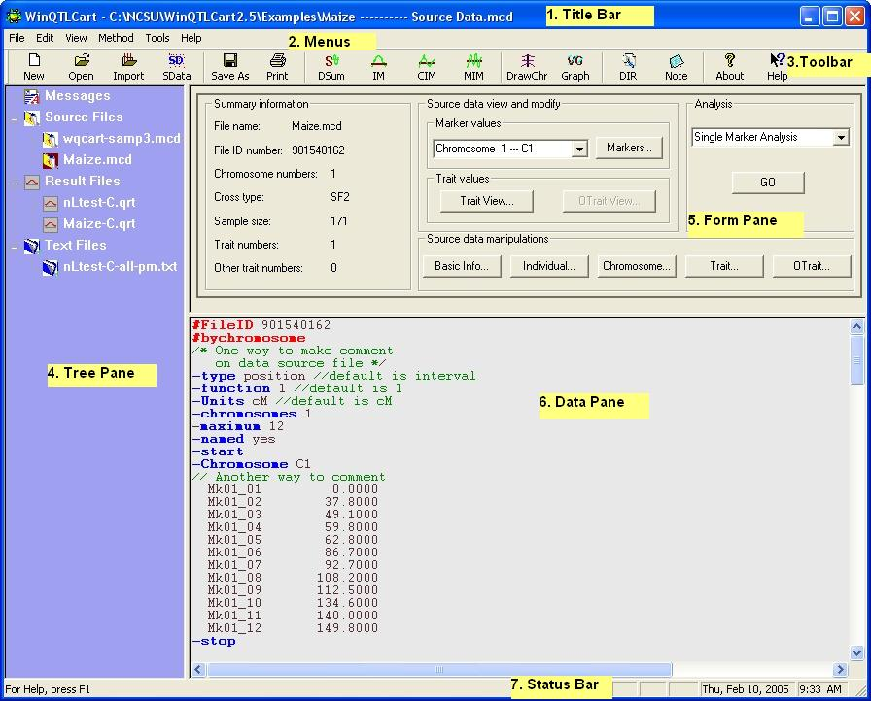
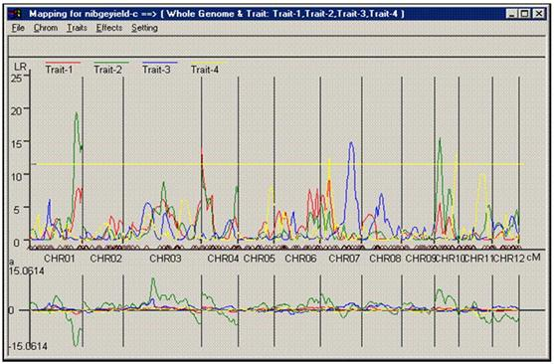
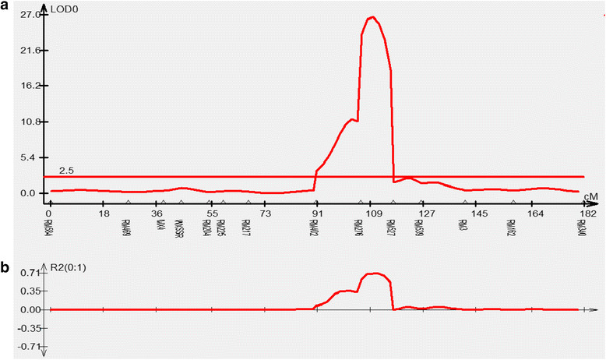
QTL Cartographer

Slide 6
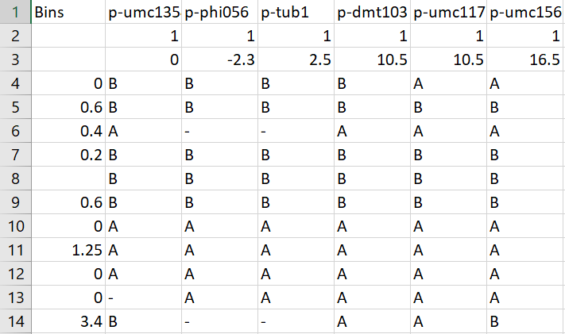
R/qtl + qtl2
Example input for R/qtl

Slide 7
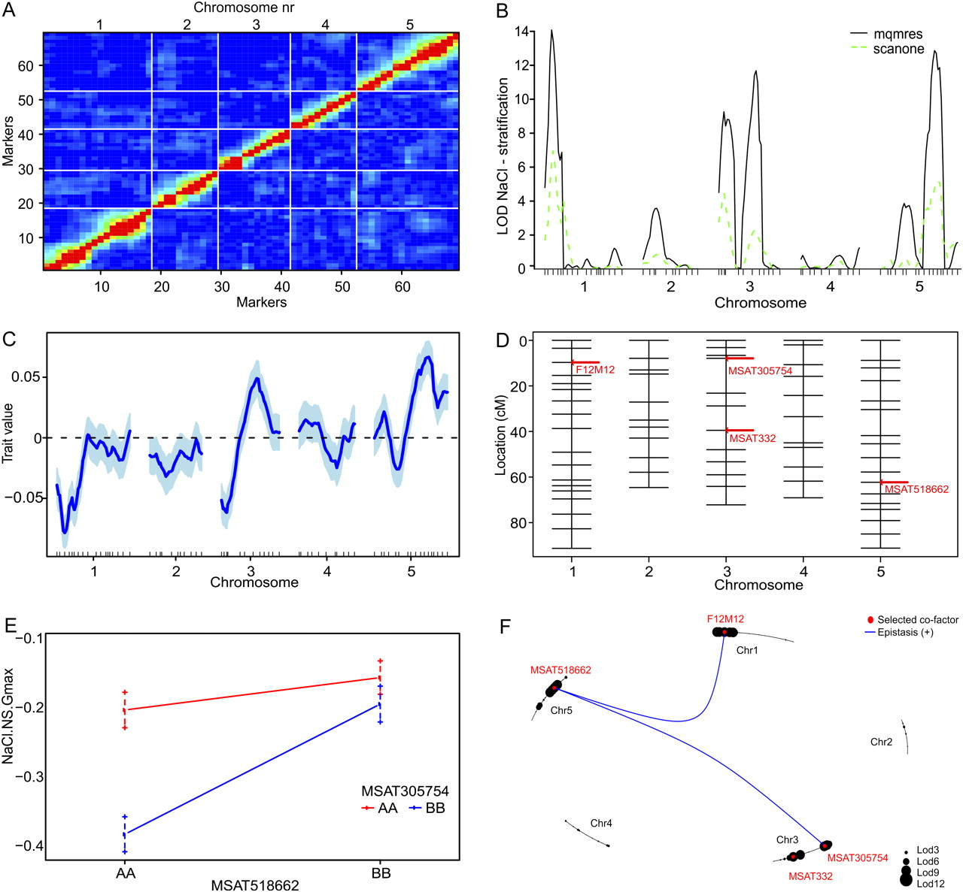
R/qtl + qtl2
Example output for R/qtl
Cons:
Require extensive data formatting (error prone)
Long runtimes
Knowledge of running jobs on HPCs for permutation tests
Intermediate file sizes large

Slide 8
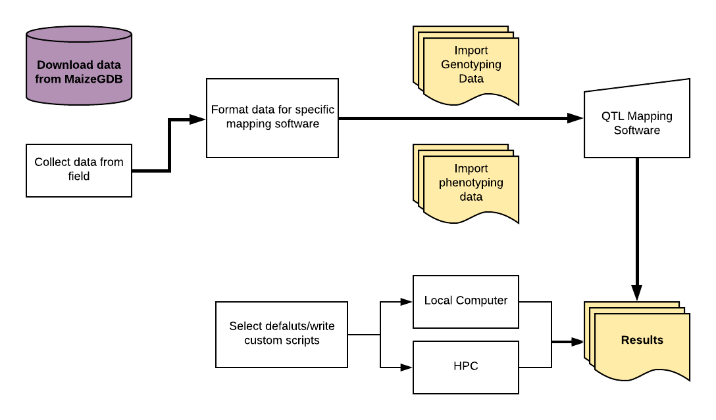
IBM 94/302
Ames
282 Assoc. Panel
NAM

Slide 9
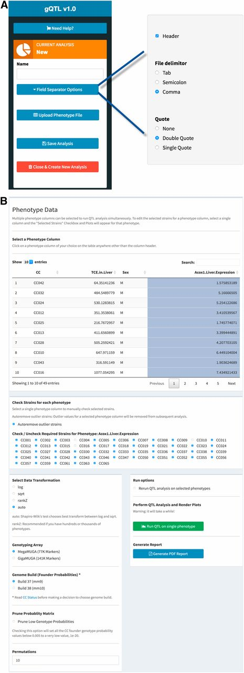
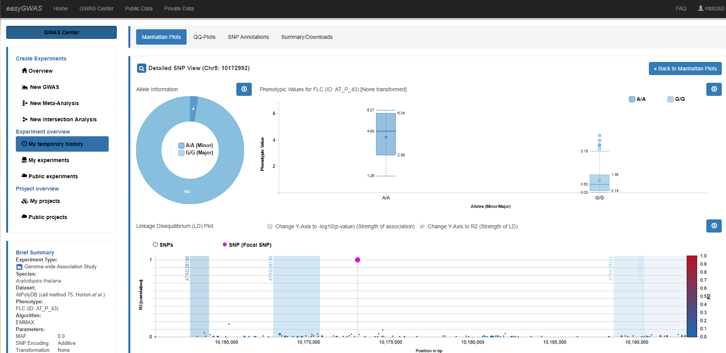
gQTL for collaborative cross mouse RILs
esayGWAS, 4 species, data preloaded

